Slide 1
Arbitrary Waveform Generator
DTRI EPD-Oct 2024 –Team 2

Slide 2
Specifications
Sl No | Parameter | Specifications | Remarks
1 | Max Frequency | 100 MHz
2 | Bandwidth | 10 MHz | Changed from 40 to 10 MHz after Review No.3
3 | Max Output Voltage | <whatever DAC supports is Okay>
4 | Sampling rate | <whatever DAC supports is Okay>
5 | Resolution | 12-bit DAC
6 | Memory | <whatever STM supports is Okay>
7 | Waveform repetition support | Yes
8 | Standard Waveforms | Sine,Cosine,Square(Variable Duty Cycle),Noise
9 | Userdefined waveforms | Accept *.txt (Integer,Hex,Float values)
10 | Channel | Single ( Option to go dual )
11 | Clock Output | Yes
12 | UI | User defined - waveform type, frequency,bandwidth,duty cycle,output voltage level
13 | Impedance | 50 Ohms
14 | Interface | USB to PC
15 | Dimensions | LxWxH ( 4inX2inX2in)
16 | Weight | <500gms
17 | Connectors | 3BNC
18 | Power | USB or Adaptor

Slide 3
Project review No.3 dt.01.01.2025
Take Aways / Homework points :
Use GNU Octave to generate waves and check their outputs – Text files generated during python
Based on the memory capacity of STM you decide whether to retain floating point inputs or not
Thoroughly check and understand DAC requirements and specs, DAC sampling rate, frequency, bandwidth etc
Check what will be the full-scale output of DAC. This is a very important feature
The noise requirement is AWGN – Arbitrary White Gaussian Noise – Study more on noise generation, check whether DAC support Noise generation, if so get the details
Memory capacity to be finalized based on the input – considering floating point input
Give the clock frequency output in the range of 1 MHz to 10 MHz
Bandwidth can be kept as 10MHz and for frequency values of less than 10 MHz take the bandwidth as 10% of the required output frequency. Bandwidth is a requirement for both Arb waves and for noise – Specification changed accordingly
9. Study the specs of STM 32 446 series
10. Elaborate the block diagram with finer details.
11. Are you going to use USB as the the input for passing .txt files to STM ?
12. Study the frequency domain of white noise
13. Roles and responsibilities and timeline has to be elaborated and mention the details based on the project development headings.

Slide 4
Project review No.3 dt.01.01.2025
Inputs / Clarifications :
User inputs in the arb directly can be taken from the touch screen for standard wave forms
Waves can be in 3 phases : Equation based, Storage based, Arb (Blind values ie no reference )
A wave digitally is represented as discrete values of time ( sampling rate ) and discrete values of amplitude ( DAC )
Clock frequency output to user can be fixed. It need not be variable
4. Use .txt files as standard format for taking inputs
5. Duty cycle is an input that is required for generation of square waves. This input has to be taken from the user
6. Two channels are necessary as mentioned in the spec sheet
7. All the calculations for wave forms are wrt to time domain and not wrt frequency domain

Slide 5
Project review No.4 dt.13.01.2025
Take Aways / Homework points :
Check Digilant website
The max scale reading of DAC of 3.6 Volts is okay
What will the clock frequency for output to the customer
Prepare a more granular block diagram
Have the display within 2” and what will the display in the screen ( Real time wave form generation is not necessary on the screen, if the screen displays waveform characteristics that is sufficient )
Check whether battery is necessary, if so what spec battery will be used and it should be a rechargeable battery
What should be the input power and how the power input will be given. Prepare a power budget for your equipment

Slide 6
Project review No.5 dt.15.01.2025
Take Aways / Homework points :
Revision history of previous revisions need to be properly edited ( Resp : PC ) – A/O
Key features in the documentation file should include technical details ( Resp : VK ) – A/O
Prepare a detailed block diagram with the understanding of component selections as on date (Resp : PC) – A/O
Prepare a flow chart for usage of touch screen and create screens with proper color scheme and UI ( Resp : VK ) – A/O
Check for data sheets of AWG of various manufacturers and prepare a similar data sheet for your equipment as well ( Resp : PC ) - Pending
Use a terminal application and transfer a .txt file to the microcontroller ( Resp : SV ) - Pending
Prepare a software architecture for your project ( Resp : PC ) - Pending
Finalize the mechanical dimensions of the AWG ( Depends of Screen selection ) ( Resp : VK ) –( 6” X 5” X 4” )
Select the appropriate touch screen ( You may check DWIN website and also download the suitable SDK ) ( Resp : VK ) - WIP
Update the Roles and responsibilities ( Resp : PC ) – A/O
Check a demo frequency multiplication POC using ST446 microcontroller / Use of External DAC ( Resp : SV ) - WIP
Along with Mouser you can also check for parts availability in Digikey website as well
Have multiple options like file transfer from PC to MC through USD, Use of SD card and entering custom options into the AWG

Slide 7
Project review No.6 dt.22.01.2025
Sl No | Review Point | Resp | Status | Remarks
1 | Update Key features and specifications. One Example of specifications of Fluke 80 / 81 series can be referred and prepare a similar specification table for your product | VK | Pending
2 | Check and confirm whether the AWG has to be equipped with 2 channels or 1 channel is sufficient | VK | A/O | 2 Channels needed
3 | Re-do R&R, project timeline and key features of the AWG | PC | A/O
4 | Decide on the number of voltage regulators that will be required. Use LDO type voltage regulators | VK | A/O
5 | Details of DC Adaptor ( Whether mounted to board or external, power outputs etc) to be studied and finalized | VK | A/O
6 | Do some more research of MMC to understand how the SD card can transfer data to the MCU | SV | A/O
7 | Finalize the type of USB that will be used for transfer of data from PC to MCU | VK | A/O
8 | Finalize the MCU that will be required to this AWG | SV | A/O
9 | Study DACs max current rating and arrive at the resistance rating to get the required final output voltage and check and confirm the necessity of an output amplifier | VK | A/O
10 | In the block diagram – mentioned the Clock Input and Output sections separately and the user clock output should be fed from the GPIO pin and not from Clock Output as mentioned in the block diagram | SV | A/O | Changes in the block diagram
11 | The current flow at the output of DAC needs to be corrected | SV | A/O
12 | V_{DD} and V_{DDA} should be de-coupled the avoid noise infusion into V_{DDA}. If possible V_{REF} also to be decoupled | PC | A/O
13 | The layout of traces from MCU to DAC should be such that the lengths of traces should be the same | PC | Input
14 | Try to keep the thickness of the AWG to around 2” | VK | Input

Slide 8
Development of Solution
Sl.No | Option | Key Components | Remarks
1 | Using Phase Locked Loop ( PLL ) or frequency multiplier in combination with STM32H7 or ESP32-S3 | Voltage Controlled Oscillator | 511-STM32H725AEI6 PIC24FJ128GC010 FAMILY(MicroChip)
 |  | LUT ( Look Up Table )
2 | Using FPGA | FPGA
 |  | Numerically Controller Oscillator (NCO) / LUT
3 | Using Programmable Oscillator module with Microcontroller | Programmable Oscillator Module
 |  | Microcontroller
4 | Using Direct Digital Synthesis ( DDS ) chip | AD 9833
 |  | AD 9850

Slide 9
Development of Solution
Sl No | MCU Type | Processor speed | AHB Speed | APB1 Speed | APB2 Speed | Flash Memory | SRAM | Package | Price | Remarks
1 | STM32F401RE | 84 MHz | 84 MHz | 42 MHz | 42 MHz | 512 KB | 96 KB | LQFP64 | Rs.585
2 | STM32F446RE | 180 MHz | 180 MHz | 45 MHz | 90 MHz | 512 KB | 112 KB | LQFP64 | Rs.783
3 | STM32F722RE | 216 MHz | 216 MHz | 54 MHz | 108 MHz | 512 KB | 256 KB | LQFP64 | Rs.938
4 | STM32H7A3A | 280 MHz | 280 MHz | 140 MHz | 140 MHz | 1024 KB | 128 KB | LQFP64 | Rs.1202
5 | STM32H725ZG | 550 MHz | 275 MHz | 275 MHz | 275 MHz | 1024 KB | 128 KB | LQFP144 | Rs.1017
6 | STM32H725RG | 550 MHz | 275 MHz | 138 MHz | 138 MHz | 1024 KB | 128 KB | VFQFPN68 | Rs.1035
7 | STM32H725VG | 550 MHz | 275 MHz | 275 MHz | 275 MHz | 1024 KB | 128 KB | LQFP100 | Rs.1009

Slide 10
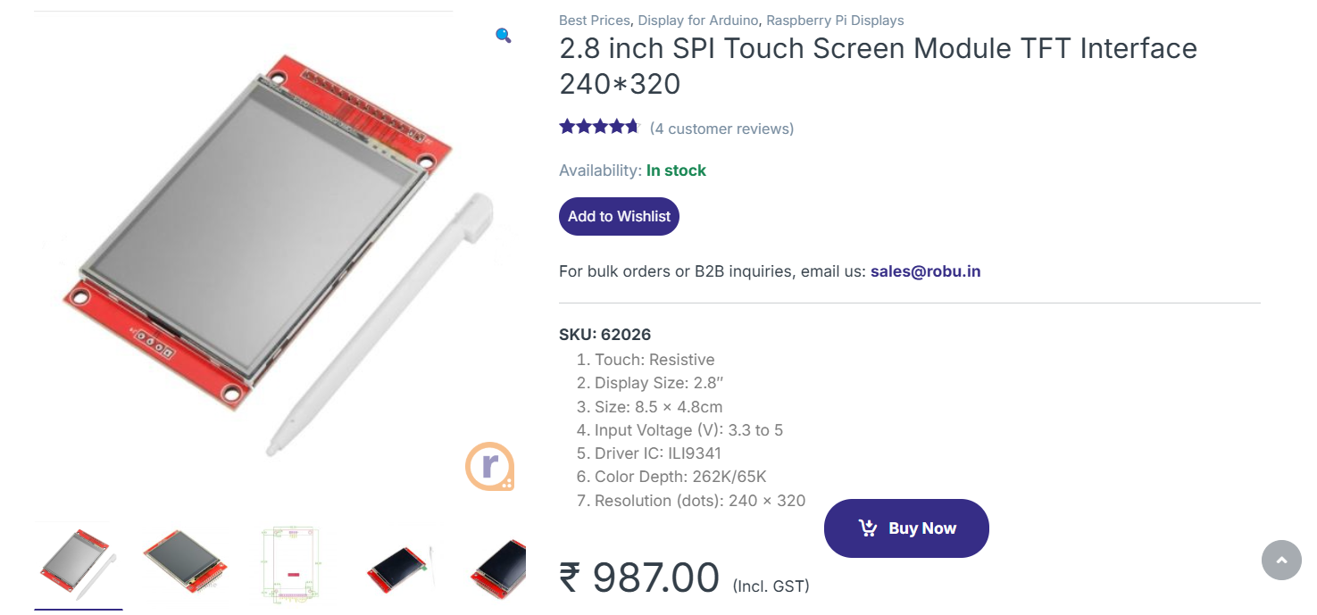

Slide 11
User Interface Screen
Sine Wave
Square Wave
Triangle Wave
Sine Wave
Square Wave
Triangle Wave
Amplitude :
Sampling rate :
Amplitude :
Sampling rate :
Frequency :
Output Channel :
Frequency :
Output Channel :
Phase Shift :
Repetition :
Phase Shift :
Repetition :

Slide 12
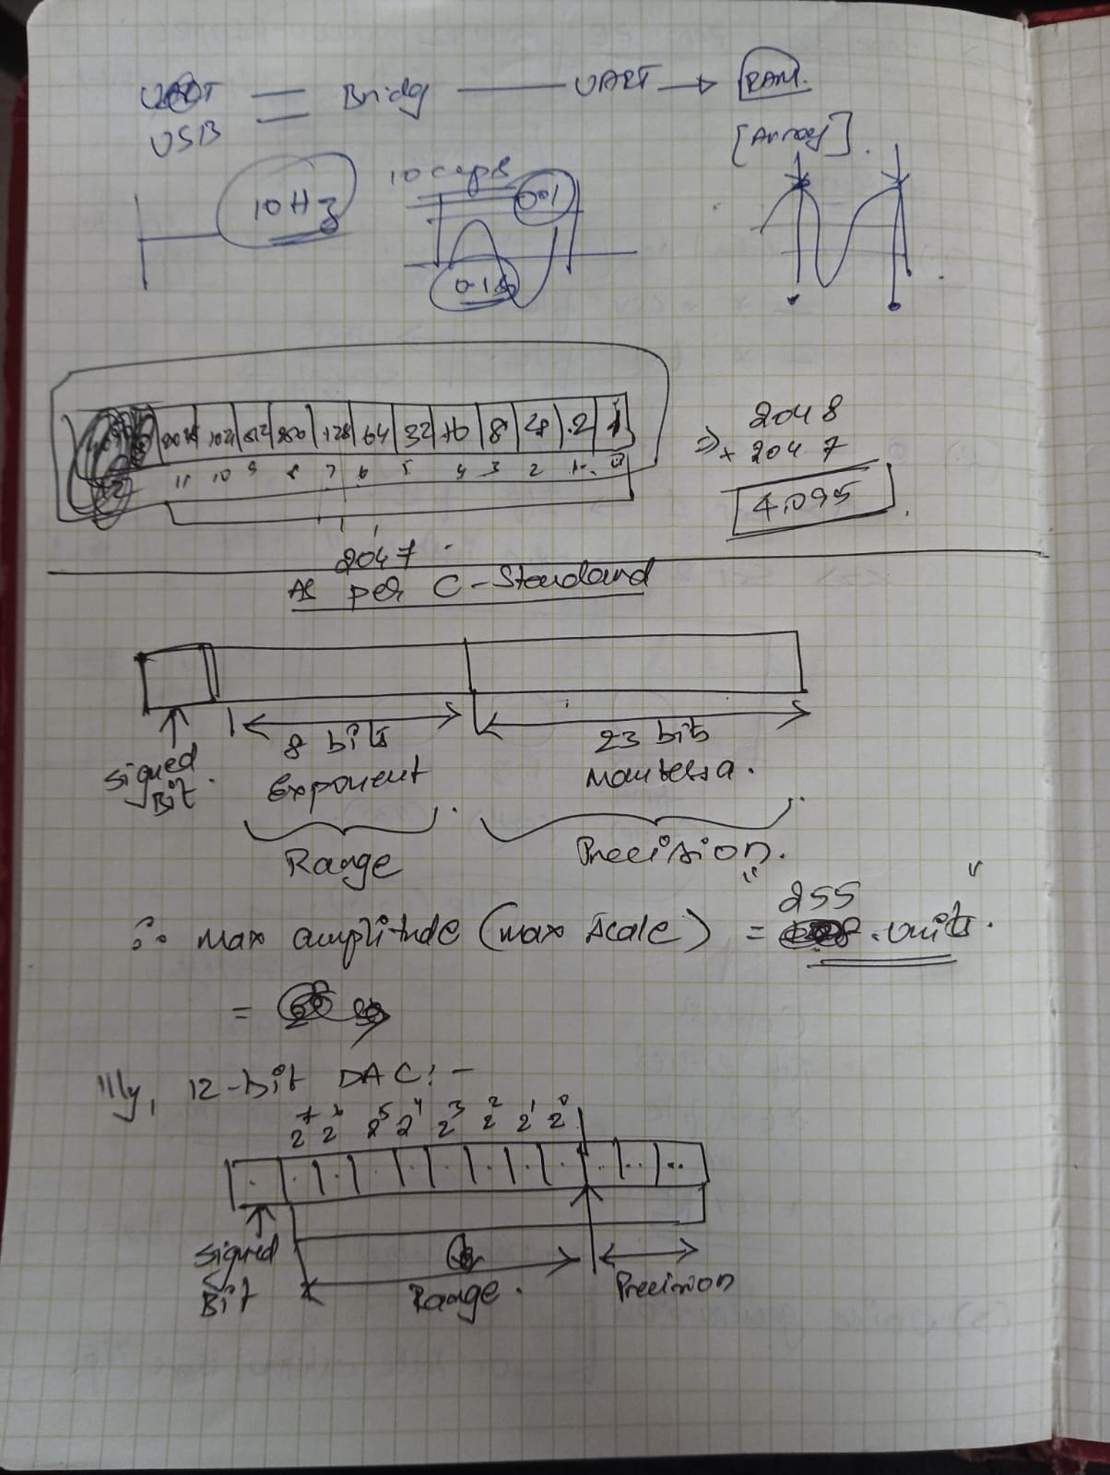

Slide 13
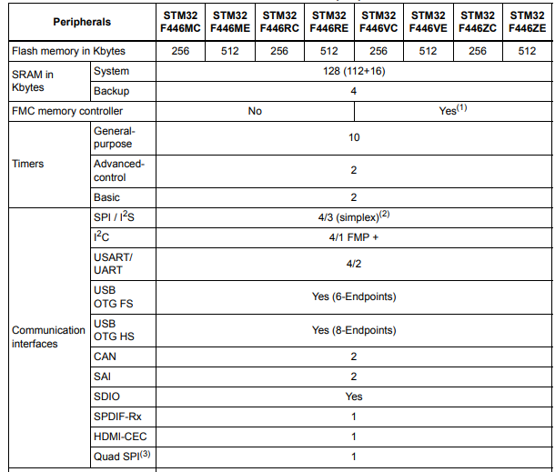
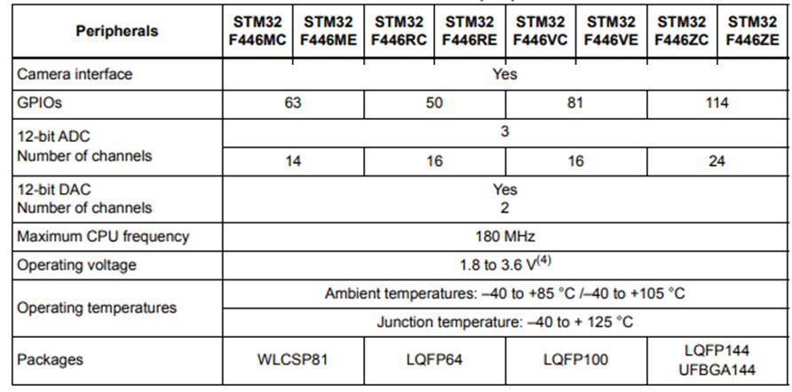
STM32F446 family microcontrollers
Pending DAC Details :
Full scale output
Noise, linearity, resolution, tolerance, max resolution

Slide 14
Digital To Analog Converters
Parallel
interface
Parallel &
buffered
QSPI with
RAM
SPI w/o
RAM
SPI with
RAM
>200 MSPS
12 bit resolution
AD9744
(Rs.2400)
12 bit resolution
AD9753
(Rs.5600)
12 bit resolution
NIL
AD3551R
(100 MHz)
AD7245A
AD9837
10 bit resolution
AD9751
(Rs.5210)
(100 MHz)
AD9833
12 bit resolution
AD9765
(Rs.3370)
12 bit resolution
AD9102
(Rs.2300)
120 to 180
MSPS
12 bit resolution
AD9706
(Rs.1580)
(60 MHz)
(60 MHz)
10 bit resolution
AD9763
(Rs.2245)
08 bit resolution
AD9709
(Rs.1680)
(60 MHz)
80 to 100
MSPS
12 bit resolution
AD9750
(Rs.1900)
12 bit resolution
NIL
(50 MHz)
10 bit resolution
NIL
08 bit resolution
NIL

Slide 15
Level 1 Block Diagram of AWG (22-01-2024)
Clock Output ( 1 – 10 MHz )
Crystal
oscillator
Output
Wave
Output
Amplifier
PC
STM32 F401
Terminal Application
Flash/
RAM
USB
3.3V
3.3V
Voltage Regulator
84MHz
VDD
3.3
SD Card
AD9744
Resistor
GPIO Ports
Clock Input
VREF
VDD
(I to V)
Clock
In/Out
Touch
Screen
Clock
Input
IOUT
Driver
MMC
Clock Output
RTC
Digital Data Input
User Input Section
SPI
GPIO
ADC
84 MHz ( Max )
Power
Supply
(DC Adaptor)
230 V AC

Slide 16
Level 1 Block Diagram of AWG (29-01-2024)
5V
D-
Clock Output ( 1 – 10 MHz )
BNC1
Type C
USB
Receptacle
D+
Oscillators
4 – 50 MHz HSE
PC
Terminal
Application
Oscillators
32.768 kHz LSE
STM32H723VG
LDO
Voltage
Regulator
Cortex M7
1MB Flash
564 kB SRAM
64 MHz HSI
USB
3.3V
48 MHz HSI
(Optional)
550 MHz
4 MHz CSI
VDD
3.3V
Output
Amplifier
SD Card
32 KHz LSI
1.2V
LPF
LDO
CD1
BNC2
CLK
DMA
CMD
CD2
AD9744
SD Card Breakout
D0 ( 3MBps)
2 X MMC
Card Detect
IDMA
25 MHz
Clock
In
Clock Input
VREF
DVDD
AVDD
50Ω
VoutA
Touch
Screen
Clock
Out
Clock
Input
IOUTA
+
Driver
GND
Clock Output
Diff
Amp
Rx
UART
IOUTB
-
Tx
FS Adj
VoutB
AHB4 275 MHz
50Ω
Digital Data Input
50Ω
User
Input Section
2 X Octo-SPI
Signal Conditioning
12-bit parallel synchronous transmission
GPIO Port
( 220 MHz)
LTDC
<=10pF lines
5V
DC Power
connector
5V
Notes:
CD : Decoupling capacitor
LPF : Low Pass Filter
R_{L} : Resistance
External area
AC Adapter
230 V AC

Slide 17
Level 1 Block Diagram of AWG (05-02-2024)
5V
D-
Clock Output ( 1 – 10 MHz )
BNC1
Type C
USB
Receptacle
D+
Oscillators
4 – 50 MHz HSE
PC
Terminal
Application
Oscillators
32.768 kHz LSE
STM32H723VG
LDO
Voltage
Regulator
Cortex M7
1MB Flash
564 kB SRAM
64 MHz HSI
USB
3.3V
48 MHz HSI
(Optional)
550 MHz
4 MHz CSI
VDD
3.3V
Output
Amplifier
SD Card
32 KHz LSI
3.3V
LPF
CD1
BNC2
CLK
DMA
CMD
CD2
AD9744
SD Card Breakout
D0 ( 3MBps)
2 X MMC
Card Detect
IDMA
25 MHz
Clock
In
Clock Input
VREF
DVDD
AVDD
50Ω
VoutA
Touch
Screen
Clock
Out
Clock
Input
IOUTA
+
Driver
GND
Clock Output
Diff
Amp
Rx
UART
IOUTB
-
Tx
FS Adj
VoutB
AHB4 275 MHz
50Ω
Digital Data Input
50Ω
User
Input Section
2 X Octo-SPI
Signal Conditioning
12-bit parallel synchronous transmission
GPIO Port
( 220 MHz)
LTDC
DAC
<=10pF lines
BNC3
5V
DC Power
connector
5V
Notes:
CD : Decoupling capacitor
LPF : Low Pass Filter
R_{L} : Load Resistance
External area
AC Adapter
230 V AC

Slide 18
Level 1 Block Diagram of AWG (12-02-2024)
5V
Clock Output ( 1 – 10 MHz )
BNC1
Type C
USB
Receptacle
Oscillators
4 – 50 MHz HSE
PC
Terminal
Application
Oscillators
32.768 kHz LSE
STM32F446VET6
LDO
Voltage
Regulator
Cortex M4
512kB Flash
112 kB SRAM
64 MHz HSI
USB
3.3V
48 MHz HSI
180 MHz
4 MHz CSI
VDD
3.3V
1V
SD Card
32 KHz LSI
BNC2
CLK
DMA
CMD
C
AD9102
SD Card Breakout
D0 ( 3MBps)
SPI
Clock
In
VREF
CLKVDD
DVDD
AVDD
Card Detect
25 MHz
R_{L}
Touch
Screen
Clock
Out
C
CLKP
IOUTP
VoutA
+
GND
RF
Transformer
SRAM
Diff
Amp
Driver
Rx
C
CLKP
IOUTN
-
Tx
UART
FS Adj
SPI Interface
R_{L}
VoutB
AHB1 180 MHz
GPIO
User
Input Section
CS
SPI 45 MHz)
SDIO
SDO
SCLK
DAC
RESET
BNC3
5V
DC Power
connector
5V
Notes:
CD : Decoupling capacitor
LPF : Low Pass Filter
R_{L} : Load Resistance
External area
AC Adapter
230 V AC

Slide 19
Level 1 Block Diagram of AWG (12-02-2024)
5V
Clock Output ( 1 – 10 MHz )
BNC1
Type C
USB
Receptacle
Oscillators
4 – 50 MHz HSE
PC
Terminal
Application
Oscillators
32.768 kHz LSE
STM32F446RET6
LDO
Voltage
Regulator
Cortex M4
512kB Flash
112 kB SRAM
64 MHz HSI
USB
3.3V
48 MHz HSI
180 MHz
4 MHz CSI
VDD
3.3V
1V
SD Card
32 KHz LSI
BNC2
CLK
DMA
CMD
C
AD9102
SD Card Breakout
D0 ( 3MBps)
SPI
Clock
In
VREF
CLKVDD
DVDD
AVDD
Card Detect
25 MHz
R_{L}
Touch
Screen
Clock
Out
C
CLKP
IOUTP
VoutA
+
GND
RF
Transformer
SRAM
Diff
Amp
Driver
Rx
C
CLKP
IOUTN
-
Tx
UART
FS Adj
SPI Interface
R_{L}
VoutB
AHB1 180 MHz
GPIO
User
Input Section
CS
QSPI ( 90 MHz)
SDIO
SDO
SCLK
DAC
RESET
BNC3
5V
DC Power
connector
5V
Notes:
CD : Decoupling capacitor
LPF : Low Pass Filter
R_{L} : Load Resistance
External area
AC Adapter
230 V AC

Slide 20
Evaluation Board

Slide 21
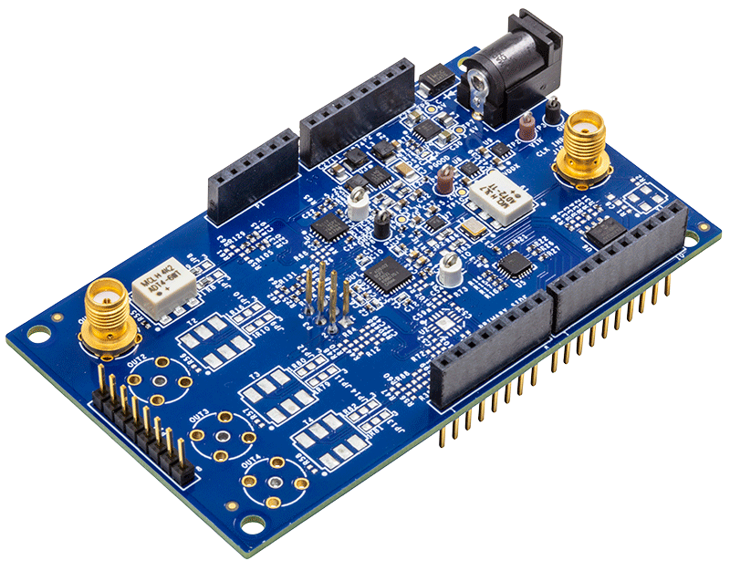
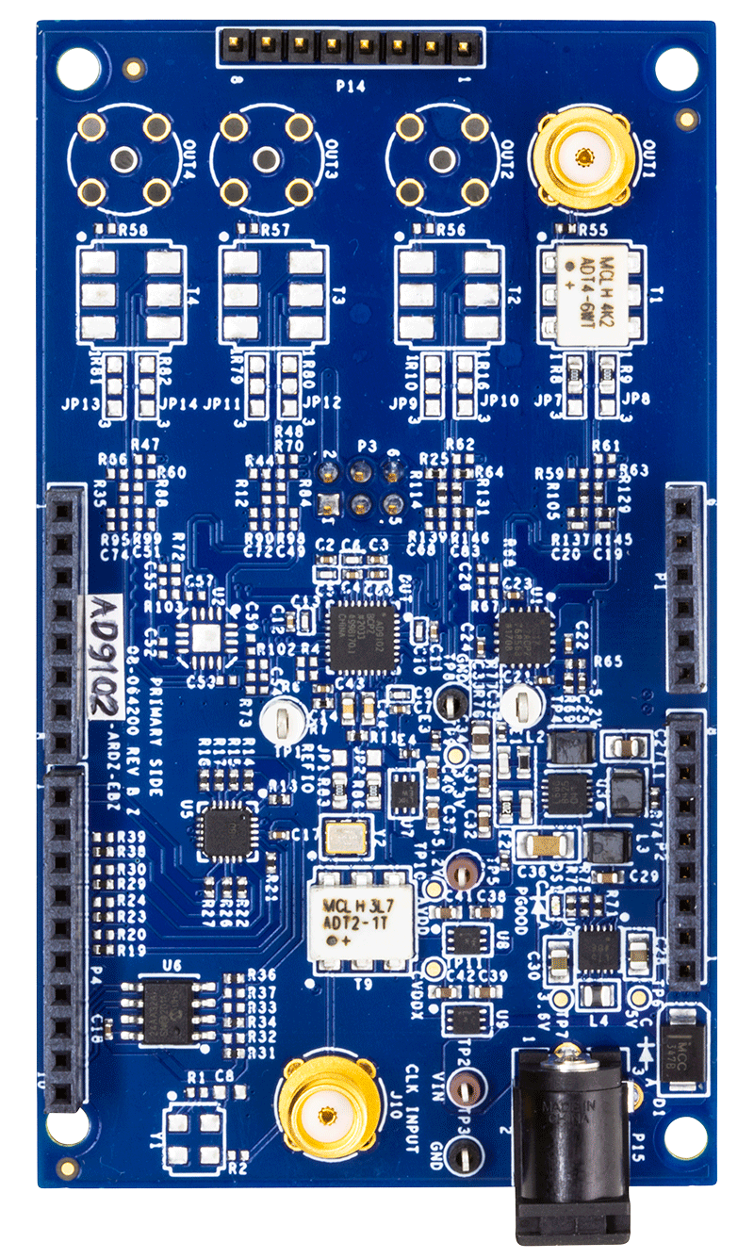
Evaluation Board
Eval Board AD9102 – ARDZ – EBZ

Slide 22
Eval Board AD9102 – ARDZ – EBZ – Block Diagram
CVDDX
Ext Clock Input
Signal
Transformer
On Board
Oscillator
Output
Jumper
Output 8 pin connector
SPI_SCK
Jumper
Signal
Transformer
DIGI 1: Arduino Conn 10pin
SPI Interface
SPI_MISO
SPI_MOSI
CKLN
CKLP
SPI_CS
DVDD
IOUTN1
IOUTP1
TRIGGER
Logic Level Translator
(1.15V to 5.5 V)
SPI_SCK
SPI_MISO
DAC
AD9102BCPZ
RESET
SPI_MOSI
AMP_P1
Op Amp
SPI_CS
AMP_N1
TRIGGER
Analog : Arduino Conn 6pin
RESET
CLKVDD
AVDD1
DVDD
I²C
R
R
R
Linear
Reg
Linear
Reg
DIGI 0: Arduino Conn 8pin
SDA
EEPROM
3.6V
CVDDX
SCL
3.6V
Step Down
Regulator
5.2V
DC-DC
Converter
6 pin connector
Linear
Reg
UART
Power Port : Arduino Conn 8pin
DC Power
Jack
Power Input

Slide 23
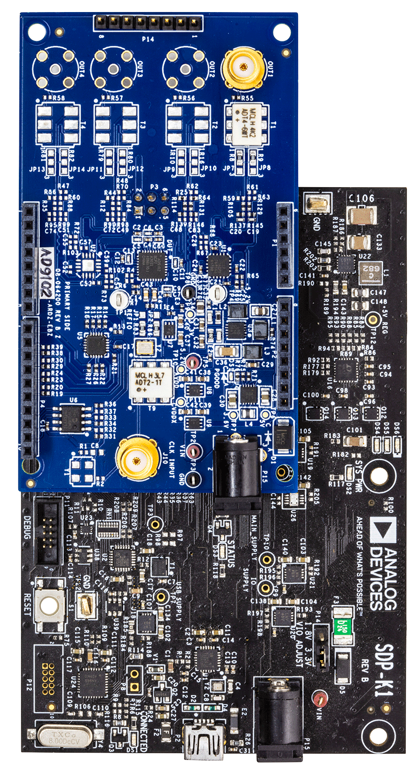
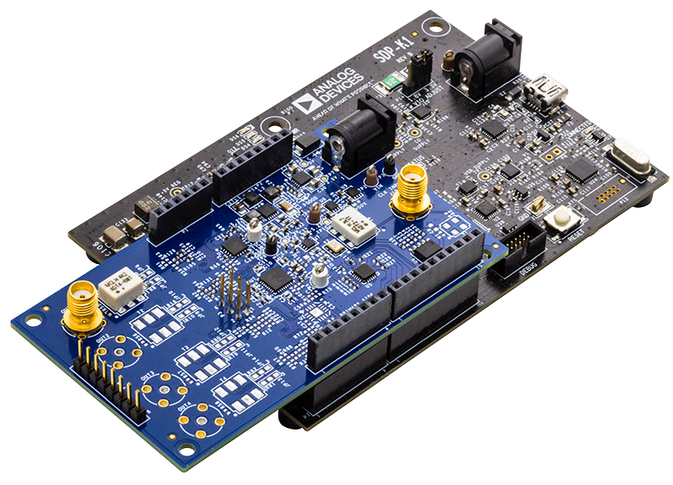
Eval Board AD9102 – ARDZ – EBZ + SDP-K1

